Slide 1
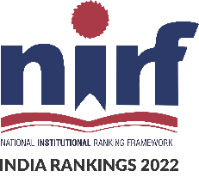


University Institute of Engineering
DEPARTMENT OF COMPUTER SCIENCE & ENGINEERING
Subject Name: Software Engineering
Subject Code: 23CST-206
Er. Jagmeet Kaur
E8387
ASSISTANT PROFESSOR
CSE
DISCOVER . LEARN . EMPOWER

Slide 2
Introduction to Software Engineering
Course Outcome
CO Number | Title | Level
CO1 | Define principles and working of software process models. | Understand
CO2 | Describe agile development methodology and analyse where to apply. | Remember

Slide 3
Topics covered
Agile Software Development
V Model

Slide 4
Agile software Development
Agile is a time-bound, iterative approach to software delivery that builds software incrementally from the start of the project, instead of trying to deliver all at once.

Slide 5
Why Agile?
Technology in this current era is progressing faster than ever, enforcing the global software companies to work in a fast-paced changing environment.
The conventional software models such as Waterfall Model that depends on completely specifying the requirements, designing, and testing the system are not geared towards rapid software development.

Slide 6
Why Agile?
As a consequence, a conventional software development model fails to deliver the required product.
This is where the agile software development comes to the rescue
It was specially designed to curate the needs of the rapidly changing environment by embracing the idea of incremental development and develop the actual final product.

Slide 7
Characteristics of Agile Model
Highest priority is to satisfy the customer through early and continuous delivery of valuable software.
It welcomes changing requirements, even late in development.
Deliver working software frequently, from a couple of weeks to a couple of months, with a preference to the shortest timescale.
Build projects around motivated individuals. Give them the environment and the support they need, and trust them to get the job done.

Slide 8
Characteristics of Agile Model
Working software is the primary measure of progress.
Simplicity the art of maximizing the amount of work not done is essential.
The most efficient and effective method of conveying information to and within a development team is face-to-face conversation.

Slide 9
Development Process in Agile
In Agile development, Design and Implementation are considered to be the central activities in the software process.
Design and Implementation phase also incorporate other activities such as requirements elicitation and testing into it.
In an agile approach, iteration occurs across activities.
Therefore, the requirements and the design are developed together, rather than separately.
.

Slide 10
Development Process in Agile
The allocation of requirements and the design planning and development as executed in a series of increments.
In contrast with the conventional model, where requirements gathering needs to be completed in order to proceed to the design and development phase, it gives Agile development an extra level of flexibility.
An agile process focuses more on code development rather than documentation.

Slide 11
Advantages
Deployment of software is quicker and thus helps in increasing the trust of the customer.
Can better adapt to rapidly changing requirements and respond faster.
Helps in getting immediate feedback which can be used to improve the software in the next increment.
People – Not Process. People and interactions are given a higher priority rather than process and tools.
Continuous attention to technical excellence and good design.

Slide 12
Disadvantages
In case of large software projects, it is difficult to assess the effort required at the initial stages of the software development life cycle.
The Agile Development is more code focused and produces less documentation.
Agile development is heavily depended on the inputs of the customer. If the customer has ambiguity in his vision of the final outcome, it is highly likely for the project to get off track.

Slide 13
Disadvantages
Face to Face communication is harder in large-scale organizations.
Only senior programmers are capable of taking the kind of decisions required during the development process.
Hence it’s a difficult situation for new programmers to adapt to the environment.

Slide 14
V Model
The V-model is a type of SDLC model where process executes in a sequential manner in V-shape.
It is based on the association of a testing phase for each corresponding development stage.
Development of each step directly associated with the testing phase.
The next phase starts only after completion of the previous phase i.e. for each development activity, there is a testing activity corresponding to it.

Slide 15
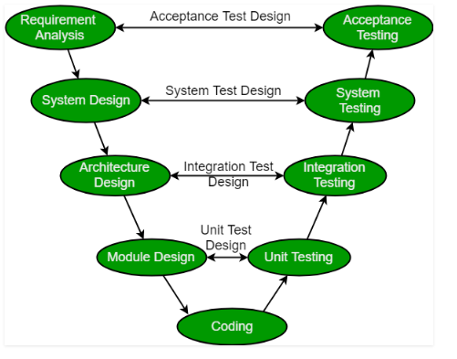
V Model
Fig 1 V Model

Slide 16
Phases of V Model : Design Phase
Requirement Analysis:
This phase contains detailed communication with the customer to understand their requirements and expectations.
This stage is known as Requirement Gathering.
System Design:
This phase contains the system design and the complete hardware and communication setup for developing product.

Slide 17
Phases of V Model : Design Phase
Architectural Design: System design is broken down further into modules taking up different functionalities.
The data transfer and communication between the internal modules and with the outside world (other systems) is clearly understood.
Module Design: In this phase the system breaks down into small modules. The detailed design of modules is specified, also known as Low-Level Design (LLD).

Slide 18
Phases of V Model : Testing Phase
Unit Testing: Unit Test Plans are developed during module design phase. These Unit Test Plans are executed to eliminate bugs at code or unit level.
Integration testing: After completion of unit testing Integration testing is performed. In integration testing, the modules are integrated and the system is tested. Integration testing is performed on the Architecture design phase. This test verifies the communication of modules among themselves.

Slide 19
Phases of V Model : Testing Phase
System Testing: System testing test the complete application with its functionality, inter dependency, and communication. It tests the functional and non-functional requirements of the developed application.
User Acceptance Testing (UAT): UAT is performed in a user environment that resembles the production environment. UAT verifies that the delivered system meets user’s requirement and system is ready for use in real world.

Slide 20
Principles of V-Model
Large to Small: In V-Model, testing is done in a hierarchical perspective, For example, requirements identified by the project team, create High-Level Design, and Detailed Design phases of the project. As each of these phases is completed the requirements, they are defining become more and more refined and detailed.
Data/Process Integrity: This principle states that the successful design of any project requires the incorporation and cohesion of both data and processes. Process elements must be identified at each and every requirements.

Slide 21
Principles of V-Model
Scalability: This principle states that the V-Model concept has the flexibility to accommodate any IT project irrespective of its size, complexity or duration.
Cross Referencing: Direct correlation between requirements and corresponding testing activity is known as cross-referencing.

Slide 22
Principles of V-Model
Tangible Documentation: This principle states that every project needs to create a document. This documentation is required and applied by both the project development team and the support team. Documentation is used to maintaining the application once it is available in a production environment.

Slide 23
Why Preferred
It is easy to manage due to the rigidity of the model. Each phase of V-Model has specific deliverables and a review process.
Proactive defect tracking – that is defects are found at early stage.

Slide 24
When to use?
Where requirements are clearly defined and fixed.
The V-Model is used when ample technical resources are available with technical expertise.

Slide 25
Advantages
This is a highly disciplined model and Phases are completed one at a time.
V-Model is used for small projects where project requirements are clear.
Simple and easy to understand and use.
This model focuses on verification and validation activities early in the life cycle thereby enhancing the probability of building an error-free and good quality product.
It enables project management to track progress accurately.

Slide 26
Disadvantages
High risk and uncertainty.
It is not a good for complex and object-oriented projects.
It is not suitable for projects where requirements are not clear and contains high risk of changing.
This model does not support iteration of phases.
It does not easily handle concurrent events.

Slide 27
References
https://stackify.com/agile-methodology/#:~:text=Examples%20of%20Agile%20Methodology,pick%20one%20or%20two%20methods.
https://nptel.ac.in/courses/106/105/106105182/
https://www.agilealliance.org/agile101/
https://www.visual-paradigm.com/scrum/what-is-agile-software-development/
Image Reference https://resources.collab.net/agile-101/agile-methodologies

Slide 28
THANK YOU

